Slide 1
Blacktown Chinese Christian Church
Welcome to Our English Service 20.10.2024
English Service 9:45 – 11:00 am
Worship Songs: Passage: Speaker: Topic: Response Song: Announcements and Closing Prayer Benediction
On That Day Lighthouse Rock Of Ages Ephesians 5:8-13 TBA TBA TBA

Slide 2
BCCC english service

Slide 3

Please keep all phones on silent

Slide 4
On That Day
CCLI Licence No: 5485849

Slide 5
Verse 1
I believe in Christ, risen from the dead
He now reigns victorious, His kingdom knows no end
Through His resurrection, death has lost its hold
I know on that final day, I'll rise as Jesus rose

Slide 6
Chorus
On that day, we will see You
Shining brighter than the sun
On that day, we will know You
As we lift our voice as one

Slide 7
Chorus
'Til that day, we will praise You
For Your never-ending grace
And we will keep on singing on that glorious day

Slide 8
Verse 2
What a blessed hope, though now tired and worn
We will spend eternity around our Saviour's throne
Though we grieve our losses, we grieve not in vain
For we know our crown of glory waits beyond the grave

Slide 9
Chorus
On that day, we will see You
Shining brighter than the sun
On that day, we will know You
As we lift our voice as one

Slide 10
Chorus
'Til that day, we will praise You
For Your never-ending grace
And we will keep on singing on that glorious day

Slide 11
Bridge
Hallelujah, what a day it will be!
For at home with You, my joy is complete
As I run into Your arms open wide, I will see
My Father who is waiting for me (x2)

Slide 12
Bridge
My Father who is waiting for me

Slide 13
Chorus
On that day, we will see You
Shining brighter than the sun
On that day, we will know You
As we lift our voice as one

Slide 14
Chorus
'Til that day, we will praise You
For Your never ending-grace
And we will keep on singing on that glorious day

Slide 15
Chorus
On that day, we will see You
Shining brighter than the sun
On that day, we will know You
As we lift our voice as one

Slide 16
Chorus
'Til that day, we will praise You
For Your never-ending grace
And we will keep on singing on that glorious day

Slide 17
Tag
And we will keep on singing on that glorious day

Slide 18
My Lighthouse
Chris Llewellyn, Gareth Gilkeson © 2013 Thankyou Music (Admin. by SHOUT! Music Publishing Australia) CCLI Licence No. 5485849 . CCLI Song number: 7002032

Slide 19
Verse 1
In my wrestling and in my doubts
In my failures You won't walk out

Slide 20
Verse 1
Your great love will lead me through
You are the peace in my troubled sea
You are the peace in my troubled sea

Slide 21
Verse 2
In the silence, You won't let go
In my questions, Your truth will hold

Slide 22
Verse 2
Your great love will lead me through
You are the peace in my troubled sea
You are the peace in my troubled sea

Slide 23
Chorus
My lighthouse
My lighthouse
Shining in the darkness
I will follow You

Slide 24
Chorus
My lighthouse
My lighthouse
I will trust the promise
You will carry me safe to shore

Slide 25
Chorus
Safe to shore
Safe to shore
Safe to shore

Slide 26
Verse 3
I won't fear what tomorrow brings
With each morning I'll rise and sing

Slide 27
Verse 3
My God's love will lead me through
You are the peace in my troubled sea
You are the peace in my troubled sea

Slide 28
Chorus
My lighthouse
My lighthouse
Shining in the darkness
I will follow You

Slide 29
Chorus
My lighthouse
My lighthouse
I will trust the promise
You will carry me safe to shore

Slide 30
Chorus
Safe to shore
Safe to shore
Safe to shore

Slide 31
Bridge
Fire before us, You're the brightest
You will lead us through the storms (x4)

Slide 32
Chorus
My lighthouse
My lighthouse
Shining in the darkness
I will follow You

Slide 33
Chorus
My lighthouse
My lighthouse
I will trust the promise
You will carry me safe to shore

Slide 34
Chorus
Safe to shore
Safe to shore
Safe to shore

Slide 35
Rock Of Ages
Words by Rev A.M. Toplady, Music by Ruth Buchanan 1998 Australian Fellowship of Evangelical Students CCLI . CCLI Song number: 293103

Slide 36
Verse 1
Rock of ages cleft for me
Hide me now my refuge be
Let the water and the blood
From Your wounded side which flowed

Slide 37
Verse 1
Be for sin the double cure
Cleanse me from its guilt and power

Slide 38
Verse 2
Not the labours of my hands
Can fulfil Your law’s demands
Could my zeal no respite know
Could my tears forever flow

Slide 39
Verse 2
All for sin could not atone
You must save and You alone

Slide 40
Verse 3
Nothing in my hand I bring
Simply to Your cross I cling
Naked come to You for dress
Helpless look to You for grace

Slide 41
Verse 3
Stained by sin to You I cry
Wash me Saviour or I die

Slide 42
Verse 4
While I draw this fleeting breath
When my eyelids close in death
When I soar through realms unknown
Bow before the judgement throne

Slide 43
Verse 4
Hide me then my refuge be
Rock of ages cleft for me-

Slide 44
Verse 4
When I soar through realms unknown
Bow before the judgement throne
Hide me then my refuge be
Rock of ages cleft for me

Slide 45

Bible reading

Slide 46
Bible reading: Ephesians 5:8-13
⁸ For you were once darkness, but now you are light in the Lord. Live as children of light ⁹ (for the fruit of the light consists in all goodness, righteousness and truth)

Slide 47
Bible reading: Ephesians 5:8-13
¹⁰ and find out what pleases the Lord. ¹¹ Have nothing to do with the fruitless deeds of darkness, but rather expose them.

Slide 48
Bible reading: Ephesians 5:8-13
¹² It is shameful even to mention what the disobedient do in secret. ¹³ But everything exposed by the light becomes visible—and everything that is illuminated becomes a light.

Slide 49
Announcements

Slide 50





Account name: Blacktown Chinese Christian Church
Account number: 4216 50263
Offering
BSB: 112 - 879
Please put in "offering" as the reference
The offering box is available at the back of the hall

Slide 51
Prayer points

Slide 52
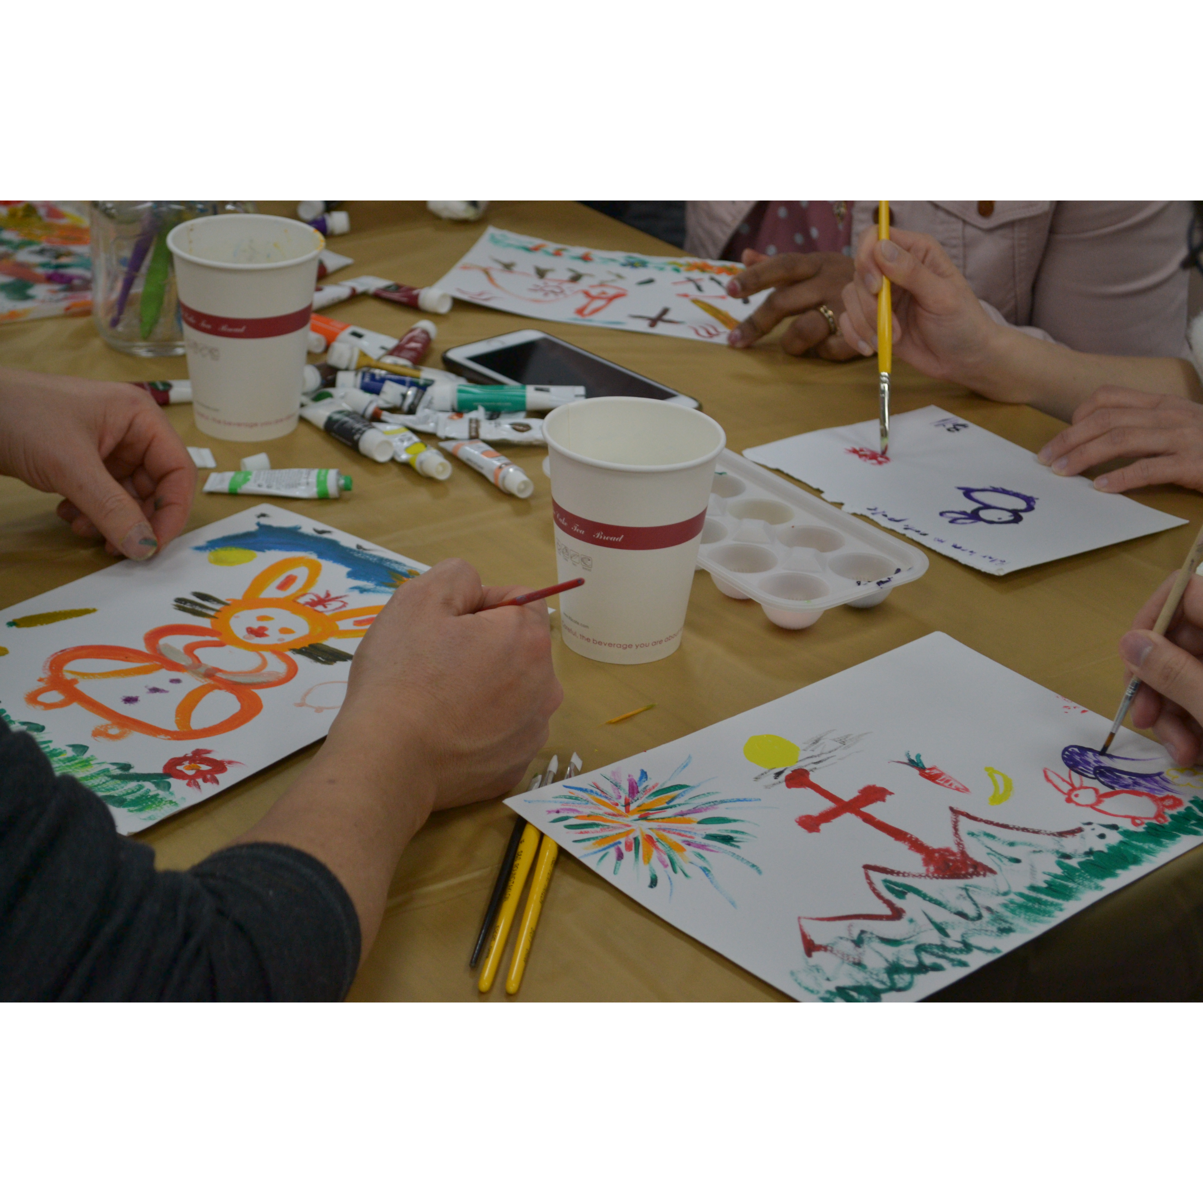
Mingle time!

